Slide 1

University Institute of Engineering
DEPARTMENT OF COMPUTER SCIENCE & ENGINEERING
Bachelor of Engineering (Computer Science & Engineering)
Subject Name : SEARCH ENGINE OPTIMIZATION
Subject Code: 20CST-463
Topic: Lecture-1.1.1
Lecture- Understanding of Search Engines
Prepared by: Sourabh Budhiraja
DISCOVER . LEARN . EMPOWER

Slide 2
Syllabus
UNIT-1: Introduction to Search Engine Optimization
CHAPTER-1: Introduction to Search Engine Optimization:
Understanding of search engines, Basics of SEO, Keyword Research, On-Page Optimization, Technical SEO.
CHAPTER-2: Content Creation and SEO tools:
Content Creation for SEO, SEO Analytics, SEO Tools, Local SEO, SEO Ethics and Future Trends.

Slide 3
CONTENTS
What are Search Engines?
What is Search Engine Optimization?
Why is SEO important?
What is Google Listing?
Why Google Listing is Important?
What does SEO do?
Why is SEO important for your business?
How SEO works?

Slide 4
What are Search Engines?
A search engine is a software system that finds web pages that match a web search. They search the World Wide Web in a systematic way for particular information specified in a textual web search query. The search results are generally presented in a line of results, often referred to as search engine results pages (SERPs). The information may be a mix of hyperlinks to web pages, images, videos, infographics, articles, and other types of files.

Slide 5
What are Search engines?(cont.)
Some search engines also mine data available in databases or open directories. Unlike web directories and social bookmarking sites, which are maintained by human editors, search engines also maintain real-time information by running an algorithm on a web crawler. Any internet-based content that cannot be indexed and searched by a web search engine falls under the category of deep web. Modern search engines are based on techniques and methods developed in the field of Information retrieval.

Slide 6
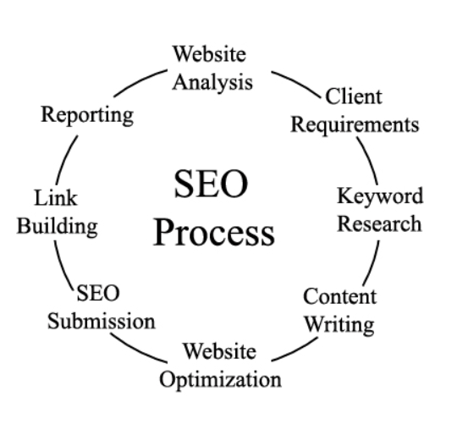
What is Search Engine Optimization?
SEO, which stands for Search Engine Optimization, is a crucial aspect of digital marketing and online visibility. It involves optimizing a website or online content to improve its visibility and ranking in search engine results pages (SERPs).

Slide 7
Why is SEO important?
To help gain more visitors: majority of users click on only the top 4-5 web pages appearing in search results, so it’s very important for a website to appear in the top results of a search engine.
Important for social promotion of a website: if a website appears in top results of a search engine such as Google, Bing, etc. then it gains instant popularity and to some extent trust of a user.
It plays an important role in improving the business of a commercial site: if two websites are selling the same product, for example, both Myntra and Koovs focus on selling fashion clothing, then the site having a better position in the search result of a search engine has chances of getting more users as compared to the other.
Improving user experience: SEO doesn’t focus only on improving search results but also on improving the user experience and usability of a website so that a website is more appealing to a user.

Slide 8
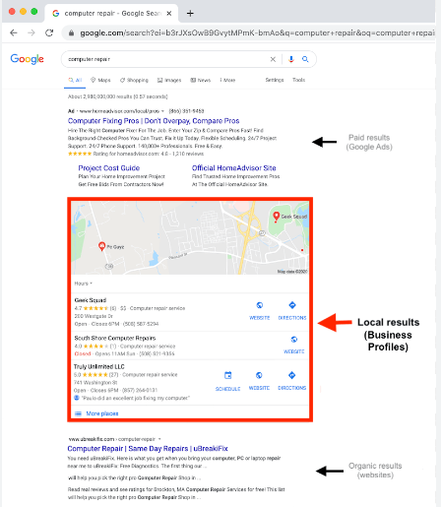
What is Google Listing?
"Google listing" typically refers to a business's presence on Google My Business (GMB), which is a free tool provided by Google to help businesses manage their online presence. The Google listing appears on Google Search and Google Maps and provides users with essential information about a business.

Slide 9
Why Google Listing is Important?
Ensuring your business's website is listed on search engines is paramount for success in the digital landscape. This strategic move significantly boosts your visibility, attracting potential customers actively seeking products or services related to your business. A strong search engine presence enhances credibility and trust, as users often prioritize websites that rank well. The competitive advantage gained through effective listing can lead to increased traffic and outperforming competitors. With a global reach, even local businesses can tap into wider audiences.

Slide 10
What does SEO do?
SEO is part of the broader topic of Search Engine Marketing (SEM), a term used to describe all marketing strategies for search. SEM entails both organic and paid search. With paid search, you can pay to list your website on a search engine so that your website shows up when someone types in a specific keyword or phrase. Organic and paid listings both appear on the search engine, but they are displayed in different locations on the page.

Slide 11
Why is SEO important for your business?
SEO is one of the most powerful digital marketing strategies you can deploy to improve sales, build credibility, increase brand awareness, and gain a leg up on your competitors.
A solid SEO foundation not only attracts new customers but also lets you deepen your business’s relationship with those customers because of the trust you establish with them.

Slide 12
How SEO works?
SEO is about both quality and quantity. Search engines want to provide the most relevant, high-quality results to searchers, so websites need substantive, helpful content and technical optimization to rank well.
A solid SEO strategy typically includes these elements:
Keyword analysis
Backlink building
Content creation
Technical maintenance

Slide 13
References
Books and Journals
Eric Enge, Stephan Spencer, Rand Fishkin, Jessie C Stricchiola, “The Art of SEO : Mastering Search Engine Optimization”, O'Reilly Media, October,2009.
https://www.hubspot.com/hs-fs/hub/53/file-13221845-pdf/docs/ebooks/introduction-to-seo-ebook.pdf
Fhttps://www.startupgeeks.it/wp-content/uploads/2018/12/ebook-seo-sej-complete-guide-2018.pdf
Video Link-
https://youtu.be/xsVTqzratPs
https://youtu.be/t12u9vD-ip0?list=PLc20sA5NNOvqY8K-gtLCljTDTP6-SMruP
Web Link-
https://www.geeksforgeeks.org/search-engine-optimization-seo-basics/
https://www.tutorialspoint.com/seo/index.htm

